Slide 1
P R E S E N T A T I O N FRONT-END APPLICATION IDEA
DEVELOPED BY: OLEG YADROSHNIKOV, FRONT-END DEVELOPER.
December 2022

Slide 2
APPLICATION FUNCTIONALITY

Slide 3
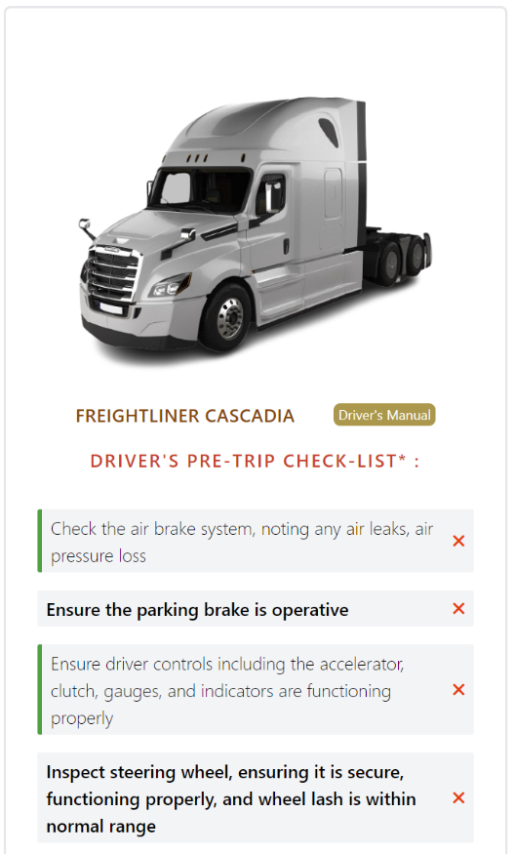
When the application is opened, the driver sees his tractor model and a list of tasks with checkpoints that are advised to check that there are no technical issues and each component functioning normally.
Driver checking his tractor components and system functionality following the list of tasks as per the application list.
Once any task is completed and checkpoint checked, it can be marked as ‘completed’ by clicking on it. As a result, the driver will see that checkpoint gets a thinner font and a green color left sidebar. So the driver can continue completing other tasks.

Slide 4
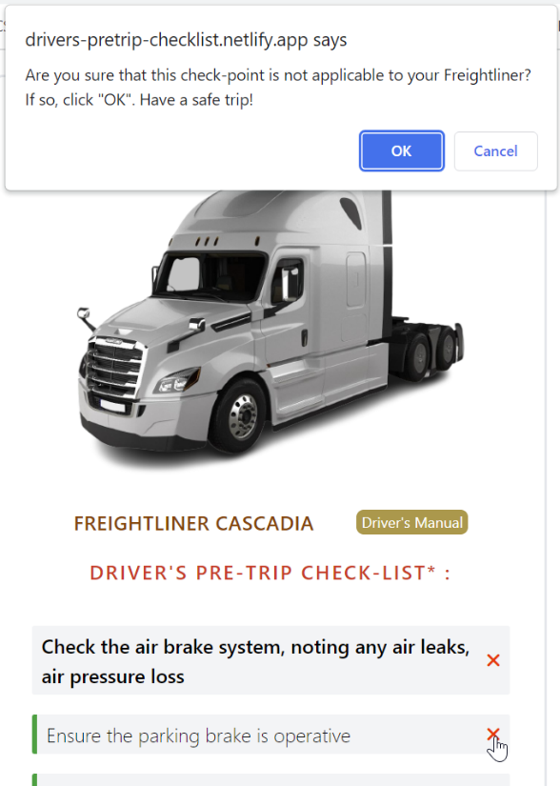
If any task is not applicable to the driver’s specific tractor for some reason, the driver can remove a task from the list by clicking on the red color cross. By removing a non-applicable task, the driver is not going to be confused while checking other tasks and the checkpoints list will be looking shorter and cleaner.
Once clicked, a notification will pop up asking the driver to make sure if that exact checkpoint is not applicable to the tractor. If the driver clicks “OK” button, the task has been removed and the updated checklist to be re-rendered.

Slide 5
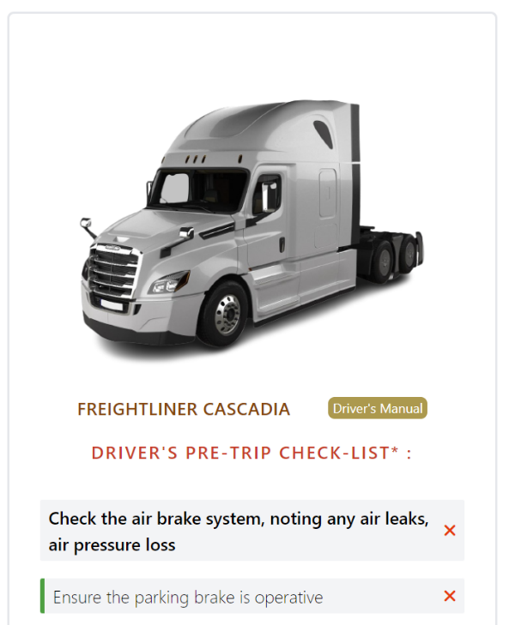
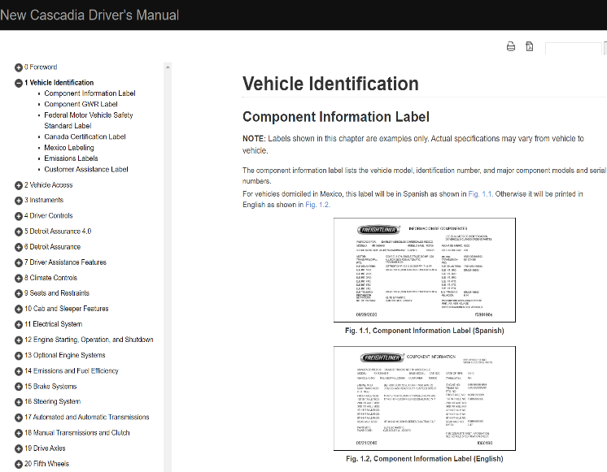
If the driver would like to check the Freightliner Cascadia tractor manual for any reason, the application allows clicking the “Driver’s Manual” button and the interactive manual will be opened in a browser new tab.

Slide 6
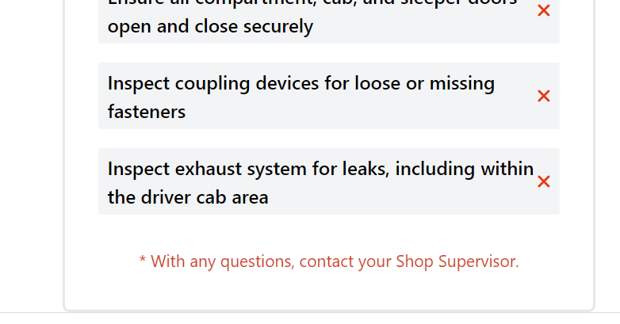
Just in case, there is a reminder (at the bottom of the tasks list) to the driver to contact his Shop Supervisor if there are any questions regarding the tractor and pre-trip checking.

Slide 7



TECHNOLOGIES USED
VUE.JS
NODE.JS
TAILWIND CSS

Slide 8
APPLICATION CAN BE REVIEWED:
LIVE:
https://drivers-pretrip-checklist.netlify.app
CODE:
https://github.com/V1Rotate/Tractor-Pretrip-Check

Slide 9
THANK YOU FOR YOUR TIME!
Respectfully,
Oleg Yadroshnikov
Cell. (204) 391-2838
contact@olegyadroshnikov.com

